Slide 1
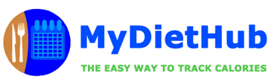
MET CS 673 - Software Engineering
Team 4
Iteration 2
Architecture, Refactoring & Testing

Slide 2
Team 4 - Members Overview
Team Leader: Ray Clark
Requirements Leader: Chen Zhao
Design & Implementation Leader: Daniel Graziano
QA Leader: But Wing Han Josephine
Configuration Leader: Huimin Diao
Security Leader: Zixia Zhou

Slide 3
Iteration 2 - Overview
Iteration 2 - Presenters:
Chen Zhao - Requirements Leader
Huimin Diao - Configuration Leader
Iteration 2 Presentation - Topics:
MyDietHub - Application Overview
Key Changes: Iteration 1 to Iteration 2
System Architecture
Software Architecture
Refactoring - Examples
Testing Plan & Results
Plan for Final Iteration 3

Slide 4
MyDietHub - Application Overview
Application Overview
Research: According to the National Health & Nutrition Examination Survey (2013–2014), approximately 2 in 3 adults in the U.S. are either overweight or obese.
App: MyDietHub is a full stack application built on modern frameworks that allows a user to compute the calories of a given food type and for an entire meal.
Purpose: The purpose of the application is to allow a user to track their caloric intake and thereby regulate their diet.
Users: Any person hoping to regulate their caloric intake and track their diet.
Notes:
As you can see, being overweight is a common problem for many Americans right now. The problem of being overweight can be linked to diet.
So the purpose of our application which named MyDietHub is to allow a user to track their caloric intake and thereby regulate their diet.
MyDietHub is a full stack application built on modern frameworks that allows a user to compute the calories of a given food type and for an entire meal.
And Any person hoping to regulate their caloric intake and track their diet.

Slide 5
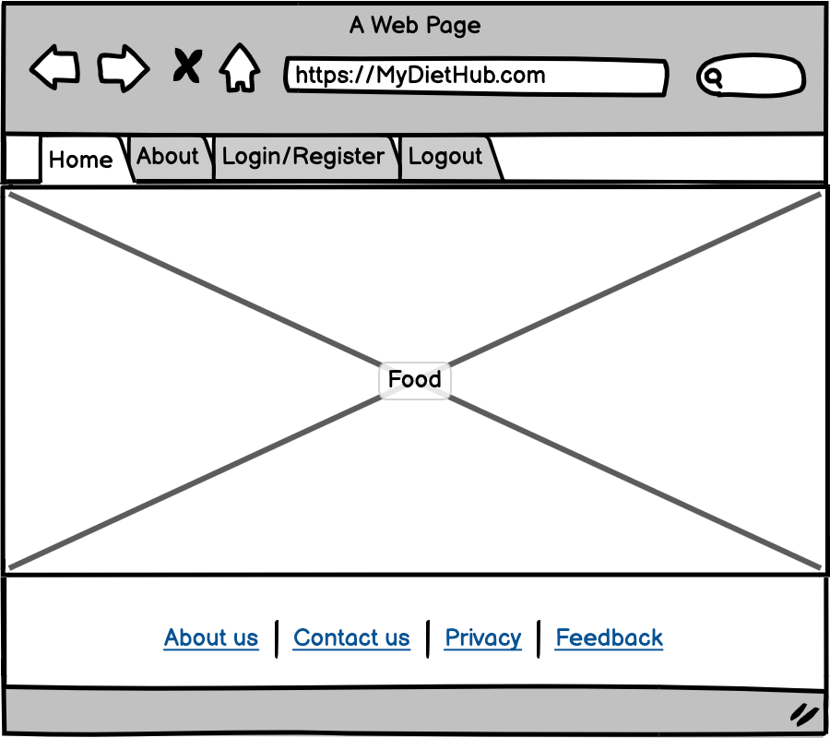
Home Page
It is a landing page (Home page).
It is a gateway to MyDietHub’s content.
Notes:
And we used Balsamiq wireframes to do the UI design, As you can see, this is the home page, and it is a gateway to MyDietHub, you can see Home, About, Login/Register Logout on the navigation bar.

Slide 6
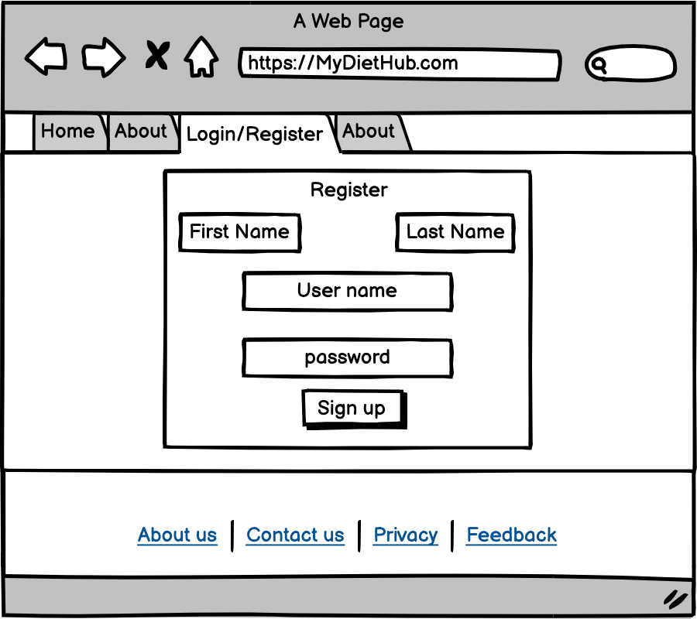
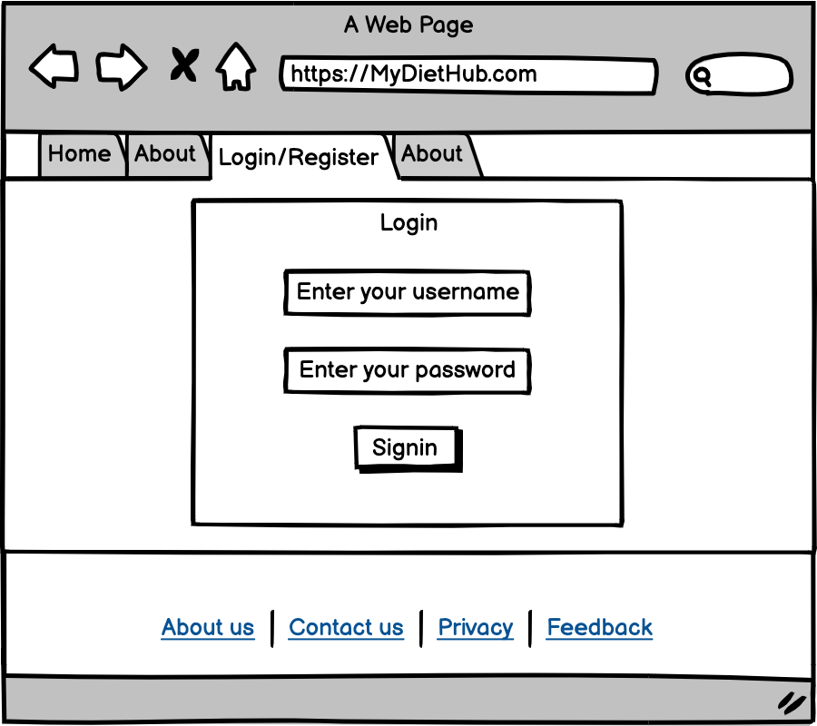
Registration/Login Page
Login form for the user to login into MyDietHub.
Registration form for the user to do registration.

Slide 7
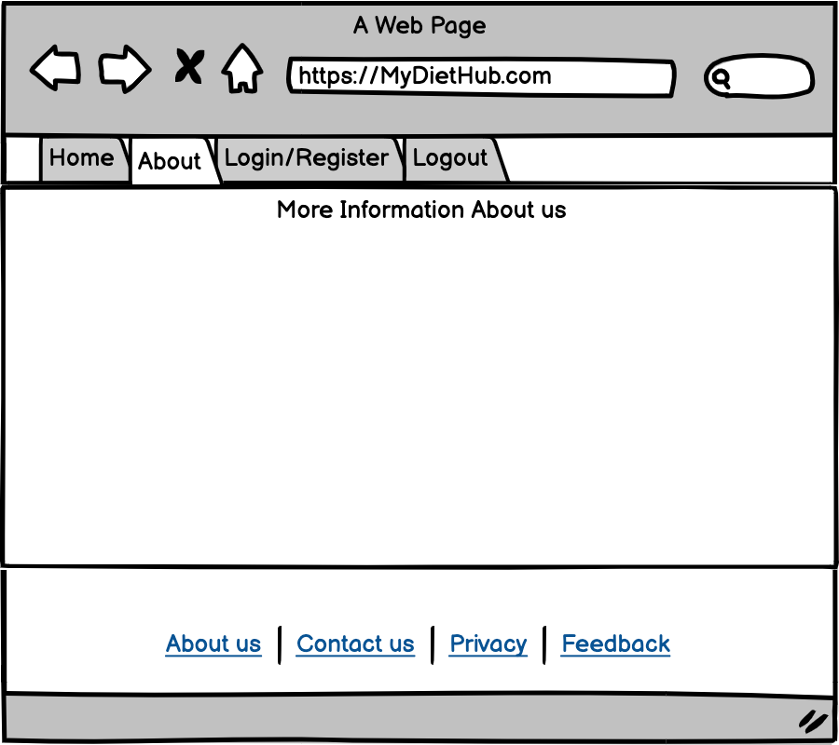
About Page
In this page, we display more information about our project. Like what it is this page and how this web page works.

Slide 8
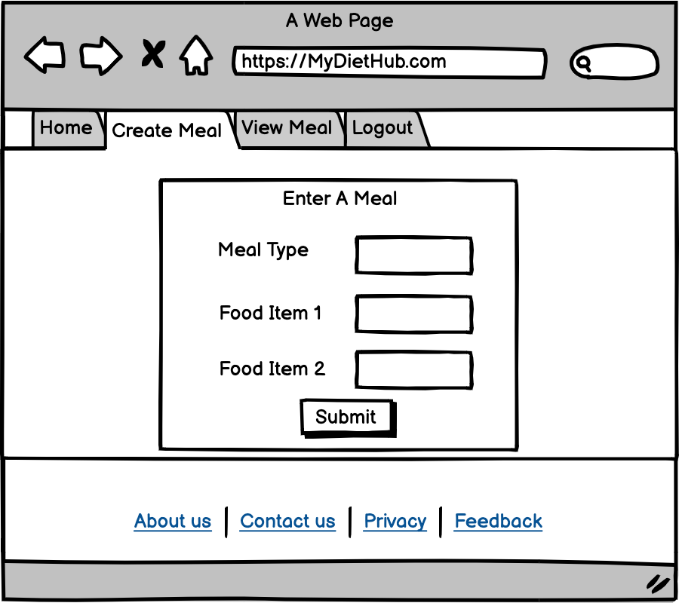
User Dashboard - Create Meal
User will navigate to the user’s dashboard page after login successfully.
User can click the “Create A Meal” button to Create a new meal which contains Meal Type and Food Items.
After input those informations, system will show the totally calories, and save this meal information.
Notes:
While this is only an MVP...limited functionality. On the Meal Input Page, you only enter: Meal Type, Food Item 1 and Food Item 2 and hit submit. There is NO weight at this point. We will do the rest things in iteration3. And a software demo video in the Iteration 2 folder is available

Slide 9
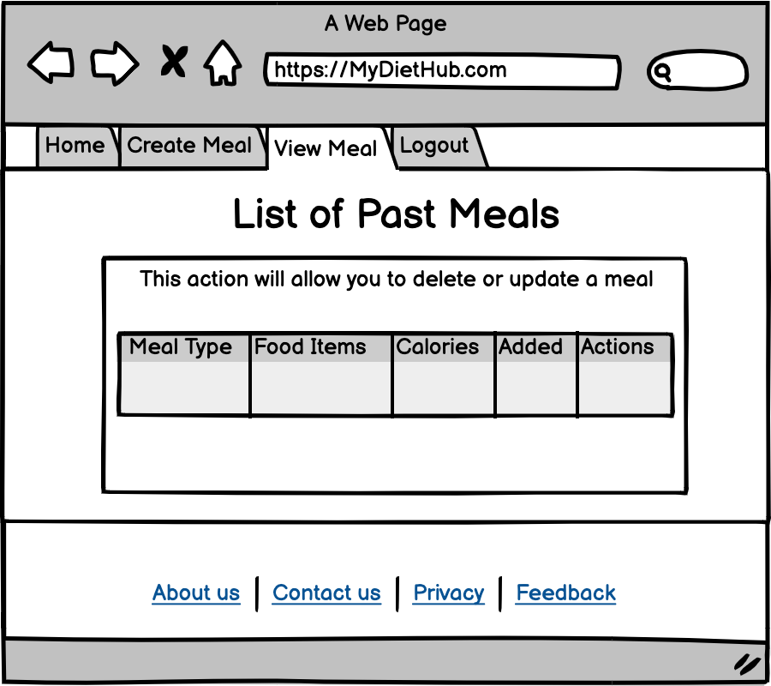
View Meal
User can view all past meals in this page, it contained with Meal Type, Food Items, Calories, Added-which is the date that user input this meal, Actions-user can update the meal information, or just delete this meal

Slide 10
Key Changes: Iteration 1 to Iteration 2
Iteration 1:
Iteration 1 - Key Outcomes:
During Iteration 1, the team completed the initial code development for three (3) distinct components:
Registration & Login Module - Single User
USDA Module - Makes API call to USDA FoodCentral DB to obtain calories by food type
CRUD Operations Module - Control code to process http requests & response
All three of these modules were built using a Python-Flask framework with simple interfaces and a SQLite database hosted locally
Iteration 2:
Iteration 2 - Key Outcomes:
During Iteration 2, the team completed the following milestones:
Combined the Reg/Login, USDA API, & CRUD modules into one (1) integrated system - MVP
Refactored these primary modules to eliminate key code smells
Completed a series of unit tests to test the primary functionality of each module and the system
Developed a detailed software & system architectural design

Slide 11
System Architecture - Layered Structure
Overview
Primary Goal - Decompose system into smaller subsystems (components) to reduce system complexity and allow for change
Subsystems or components are structured or decomposed based on functions and data flow
Broad design includes frontend, backend and data layer
From a system perspective, the design is based on a 2-tiered, layered structure
Each layer provides a related set of services to upper layers
The diagram on the following page illustrates the layered system architecture

Slide 12
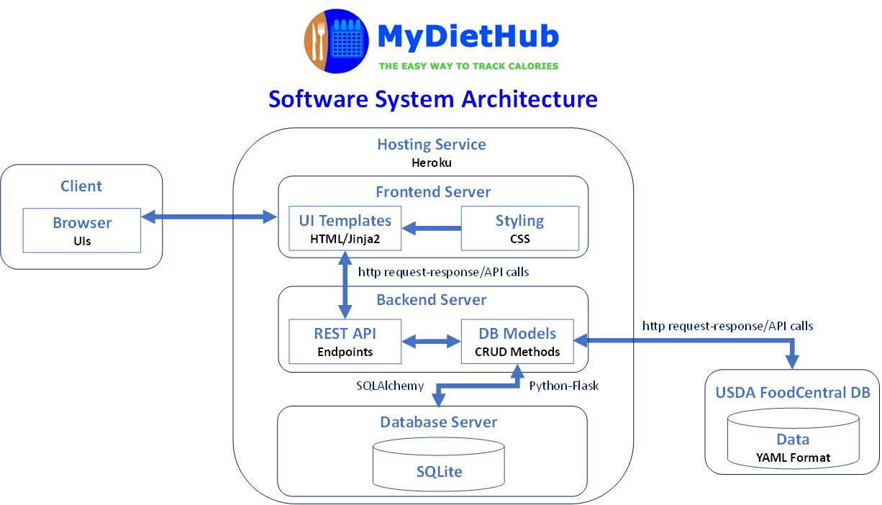
System Architecture - Layered Structure Diagram

Slide 13
Software Architecture - MVC Pattern
Overview
Model–view–controller (known as MVC) - Software design pattern commonly used to develop user interfaces that divides related program logic into three interconnected elements
MVC architecture - Model is responsible for application-domain data, View displays the model and is templates to render HTML pages, Controller (logic) handles requests & responses
MyDietHub - MVC
Data Layer (Model) is implemented using a SQLite relational database
View Layer uses interfaces developed using HTML5/CSS3 and Jinja2
Controller Layer is built as a REST API using the Python-Flask framework that provides API endpoints to perform various CRUD (create-read-update-delete) operations
The diagram on the following page illustrates the MVC software architecture

Slide 14
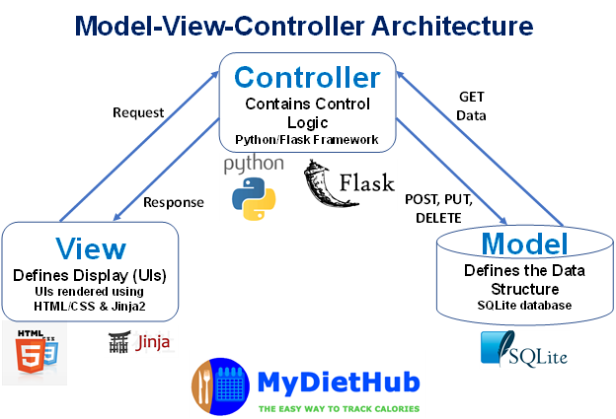
Software Architecture - MVC Pattern Diagram

Slide 15
Database Design
SQLite chosen for simplicity and integration with python/flask
Two (2) primary database Schemas are used in the system:
“User Model Table” database has 7 keys: id, firstname, lastname, email, username, password and role
“Meal Model Table” database has 6 keys: id, meal_type, food_item1, food_item2, calories, date_created

Slide 16
Database Schema Overview - User Model Table
Column name | Variable type | Unique
id (primary key) | String | True
firstname | String | False
lastname | String | False
email | String | True
username | String | True
password | String | False
role | String | False

Slide 17
Database Schema Overview - Meal Model Table
Column name | Variable type | Nullable
id (primary key) | Integer | True
meal_type | String | False
food_item1 | String | False
food_item2 | String | False
calories | Float | False
date_created | Datetime | True

Slide 18
Use Case Diagram
Overview
The use case diagram on the following page outlines how users will perform tasks on MyDietHub application
It outlines from a user’s point of view, a system’s behavior as it responds to a request
Following the use case diagram, we have included the class diagram and database design schema

Slide 19
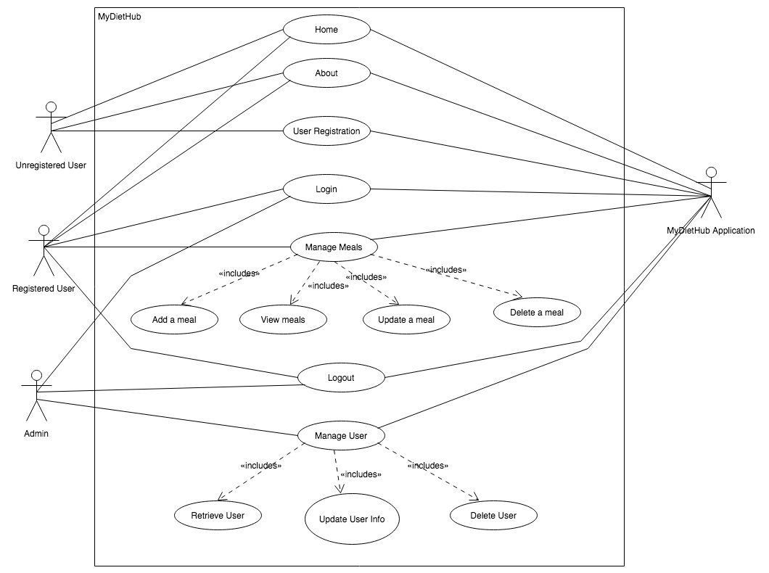
Use Case Diagram

Slide 20
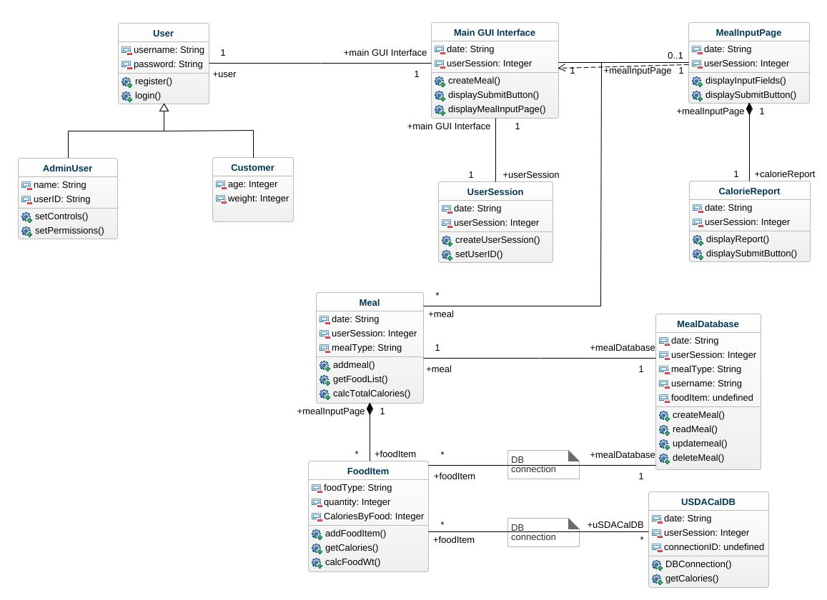
Class Diagram

Slide 21
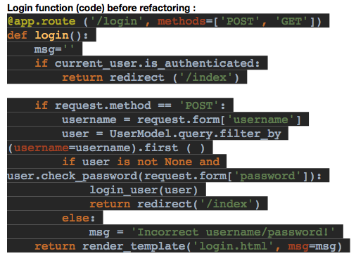
Refactoring - Example 1
During Iteration 2, the team completed initial refactoring for each of the three (3) key modules
The goal of the refactoring effort was to remove key code smells and employ a single responsibility principle by moving key functions to separate classes and files.
Examples of the refactoring effort:
Login Function Before Refactoring :

Slide 22
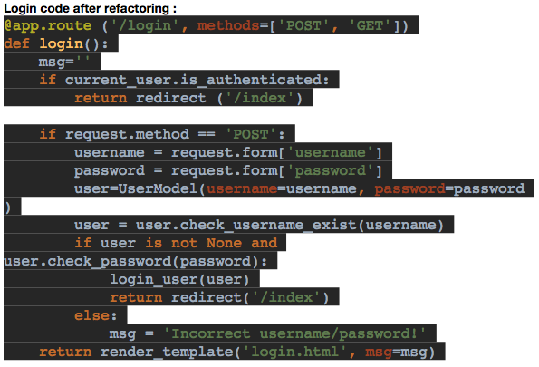
Refactoring - Example 1

Slide 23
Refactoring - Example 2
During Iteration 2, the team completed initial refactoring for each of the three (3) key modules
The goal of the refactoring effort was to remove key code smells and employ a single responsibility principle by moving key functions to separate classes and files.
Example 2 - Organization: Database code, control (route) code and Flask app instantiation code all in the same file, ‘app.py’. Screen shots below of app.py before & after refactoring show database code and routes

Slide 24
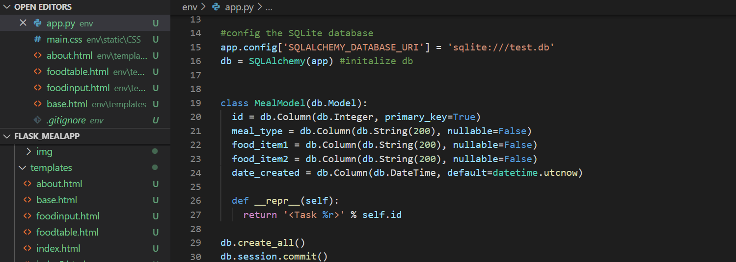
Refactoring - Example 2
Database code included in app.py before refactoring

Slide 25
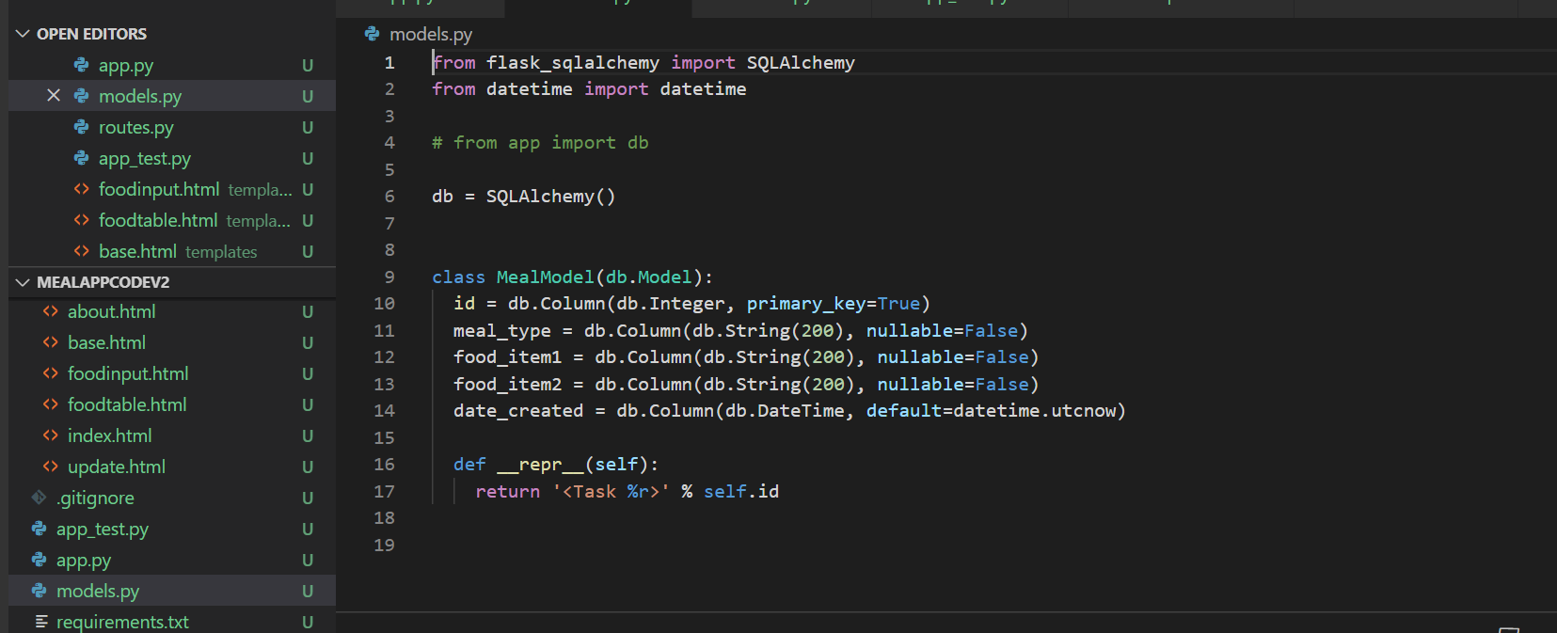
Refactoring - Example 2
Database code included in models.py after refactoring

Slide 26
Testing Plan & Results
Framework
Python unittest for unit testing
Plan to use Selenium for automated system testing
Types of testing
UI Tests
Perform manually and use black box testing
Unit Tests
Perform automatically and use white box testing
System Test
Will perform automatically and use black box testing

Slide 27
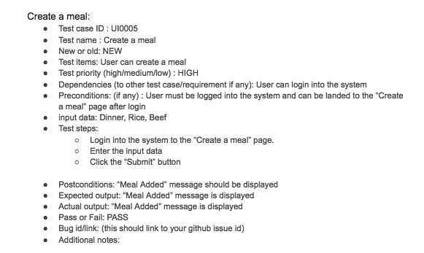
Manual UI Testing
Result: Total Number of UI Testing = 13
Number of failures = 2
Example of UI Testing :

Slide 28
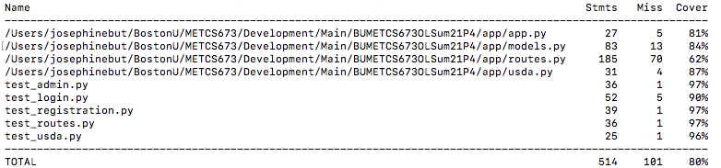
Code Coverage Report
The unit tests cover approximately 80% of the application.

Slide 29
Conclusion - Next Steps for Final Iteration
Conclusion - During this iteration 2, the team successfully completed the following tasks:
Successfully integrated three (3) modules into a fully functional MVP system
Refactored all three modules to eliminate key code smells
Completed a series of initial tests of the MVP code functionality
Next Steps - The team has the following key objectives for the final iteration 3:
Revise code to accept “multiple” food items
Be able to query DB based on varying criteria
Additional exception handling and data validation

Slide 30
User Interface (UI) Designs
On the following pages, we outline the wireframe designs for the application’s UIs:
Home Page
Registration & Login
About
Create Meal
View Meal

Slide 31
Code Demo and Release Branch Link
MyGitHub - software demo/code walk-through link:
https://drive.google.com/drive/folders/1b7rD0_OYSKx40c97Q4FVX2_E8Hv1m-tY
MyGitHub - Release branch link - Github: Iteration 2

Slide 32


